Slide 1
Destiny Discover eBooks

Slide 2
Our library has a collection of eBooks & Digital Audiobooks accessible to students and staff through Destiny Follettshelf.
Loan period for eBooks is 21 days.

Slide 3
Destiny Discover App
You can read your ebook on multiple devices, simply download the free Destiny Discover App.

Slide 4
Log In
To check out an eBook, click on the LogIn button located in the upper right hand corner of the toolbar.
Your username and password is the same information as you use in the classroom and to put a book on hold with Koha.

Slide 5
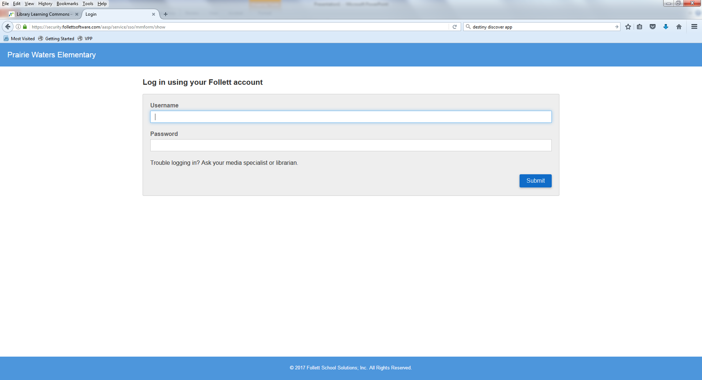
Trouble logging in?
Ask your librarian.

Slide 6
You can browse for books by: Author, Subject, Title
For example: Dogs

Slide 7
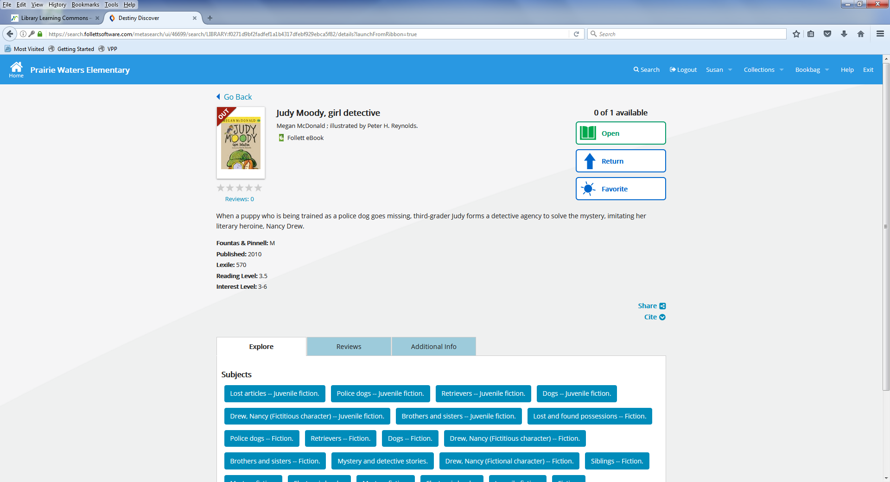
Summary
Reading level
To read an eBook click on the book cover or title. Click on the “Open” button beside the book to begin reading.
Loan Period is 21 days.

Slide 8
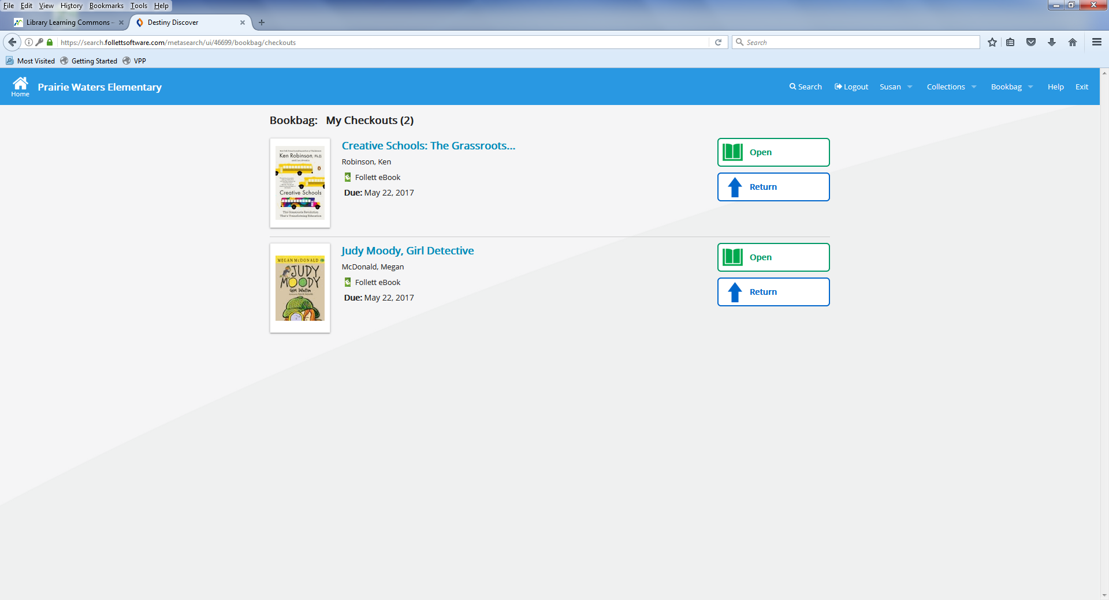
To read your book after it is checked out go to your BOOKBAG, located along the top navigation bar. Select “Checkouts” – click the “Open” button to begin reading your book.

Slide 9
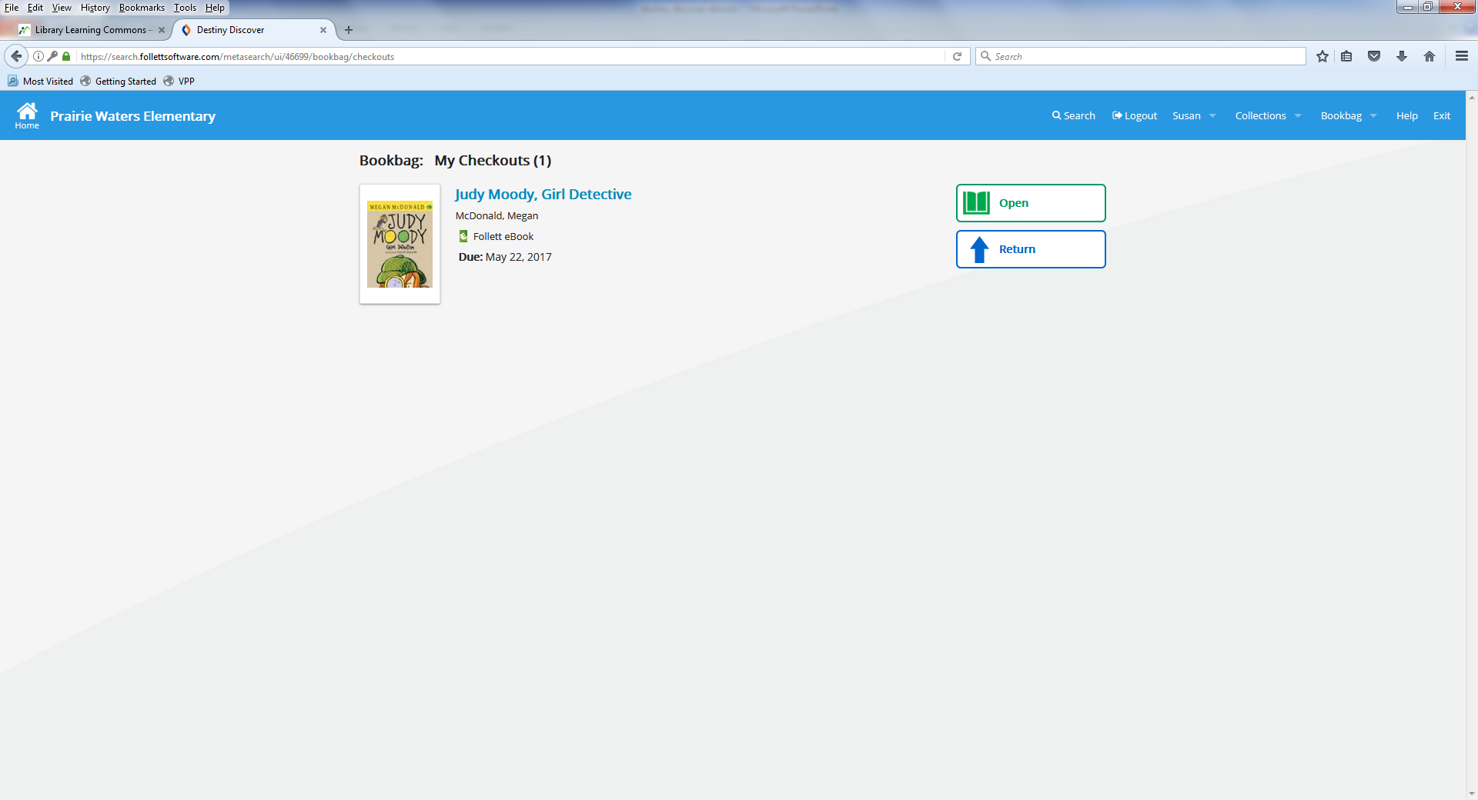
To return your book early go to your “Bookbag”. Click “Checkouts” and then click “Return”.

